Slide 1

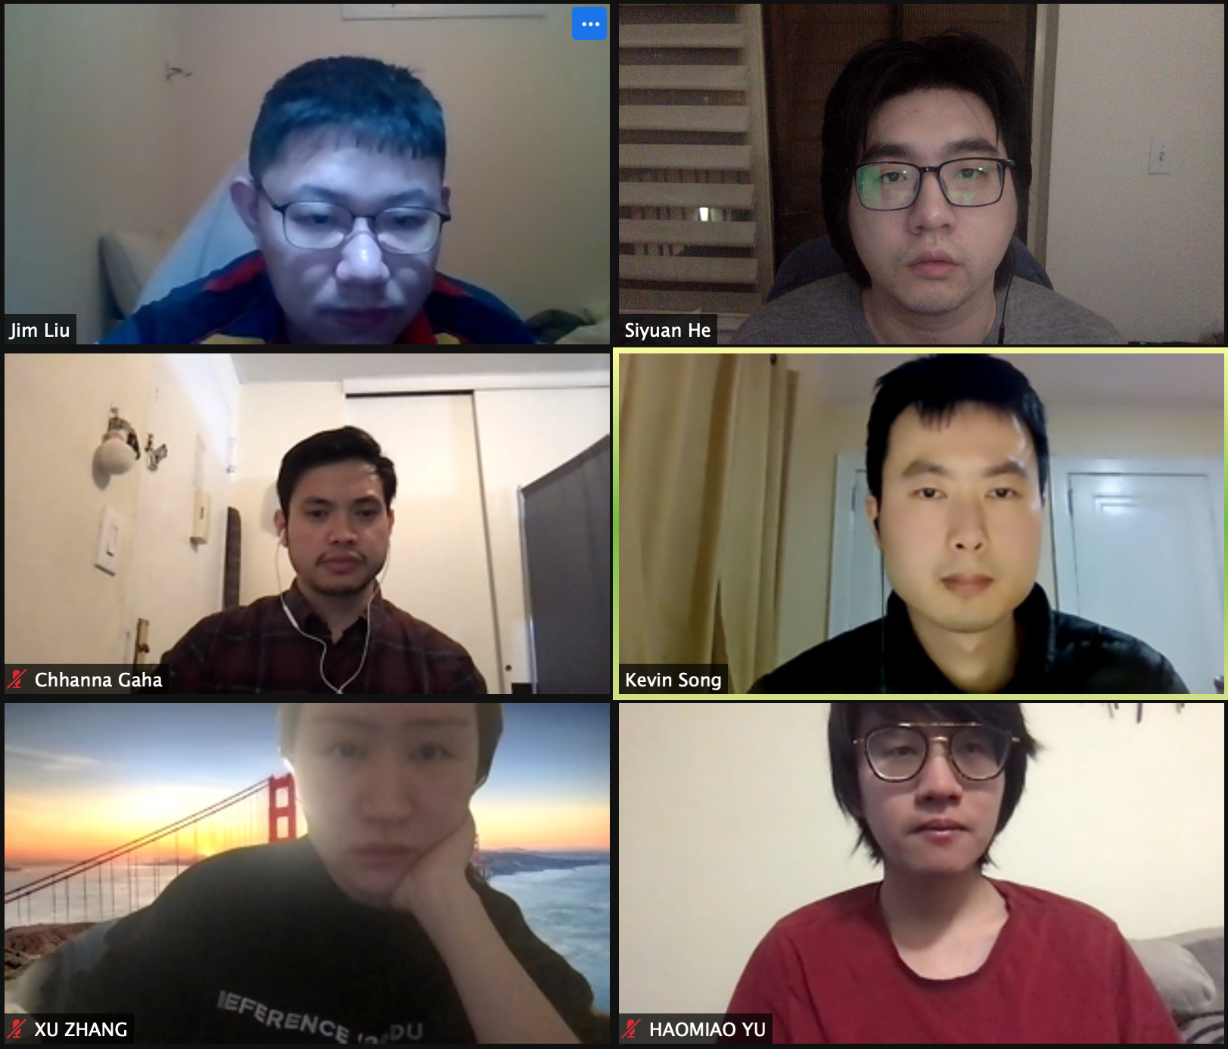
PC builder web application
Team member:
Kevin Song
Siyuan He
Xu Zhang
Haimiao Yu
Chhanna Gaha
Sichao Liu
Guided By: Professor Henry Wong
Deliverable VIII
Team Name: Dice

Slide 2

Introduction
A new application is made if a developer produces a new idea or when there is new technology to create better software. Our team viewed many existing online PC hardware stores, they are either created with older development tools or lacking functions that we need nowadays.
Therefore, we are here with a web application that is developed using React and other advanced technologies to achieve smooth browsing and satisfying functionality. The web app will help users to select and purchase the right hardware for their requirements. Users can see what other users’ reviews of different builds to help them determine if they meet their needs.

Slide 3
Persona of a college Student
Hi, I am Nancy studying Bachelor‘s in Computer Science at North Georgia University. It’s difficult for me to pick a laptop out of many brands. There are ASUS, MSI, Dell and so many famous brands with similar hardware specs. I wish there is a good online application to help me identify which will meet my requirements with the best price.

Slide 4
Persona of a software engineer
Hi, I am Jz Han. I am an experienced IT worker living in the Georgia suburb. In Georgia, the retail store is far away from where I live so I always shop for PC parts online. However, the websites that I am familiar with are only office related. They do sell PC hardware but it’s not their major business. I wish there was a web application that would just focus on selling PC parts. It sells the PC hardware I need and runs smoothly just like any other shopping website.

Slide 5
Persona of a FilMmaker
Hi, my name is Mark. I’m an MFA of Filmmaking in the School of Visual Arts in New York. Next semester I will take classes related to video editing and color correction and I’m using 4K videos instead of 1080p videos. I’m changing my main editing tool from Adobe Premiere to Davinci Resolve. I have a great Gaming Desktop and it worked well with Premiere, but after moving to Davinci it runs much slower. I was told that I need a more powerful CPU to make the Davinci work perfectly. But the current processor manufacturers have made their product numbering too complicated, and it‘s hard for someone like me who lacks hardware knowledge to pick the processor I need. I hope there will be a website that could show me the configurations of different performance levels of computers where I could find the CPU I need and place an order directly on the website.

Slide 6
Persona of a Gamer
Hi, I am Jessi, a Bachelor at Pace University. I’m a big fan of AAA PC gaming so I plan to buy a powerful desktop which can be used for heavy gaming as well as course work. However, the gaming desktop currently on the market is usually more expensive, so building one desktop by yourself will save money while having the same performance. but I don‘t know how to pick hardware, it’s too complicated for me. But I don‘t know how to pick hardware, it’s too complicated for me. I wish there will be a website that sells custom build desktops so I will get a desktop with great gaming performance at a relatively low price.

